Slide 1
Accessing the Cloud
Web Application Framework :
A web application framework is used to support the development of dynamic web sites, web applications, and web services.
The point of a framework is to reduce the overhead that comes with common activities in web development.
For instance, frameworks provide libraries that are already written so the developer doesn’t have to reinvent the wheel every time a web site is developed.
Early in the Web’s life, hypertext was mostly hand-coded Hypertext Markup Language (HTML) that was published on Web servers.
If a published page needed to be changed, it had to be done by the page’s author. As the Web grew up, it became more dynamic with the addition of the Common Gateway Interface (CGI).
This allowed external applications to interface with web servers.

Slide 2
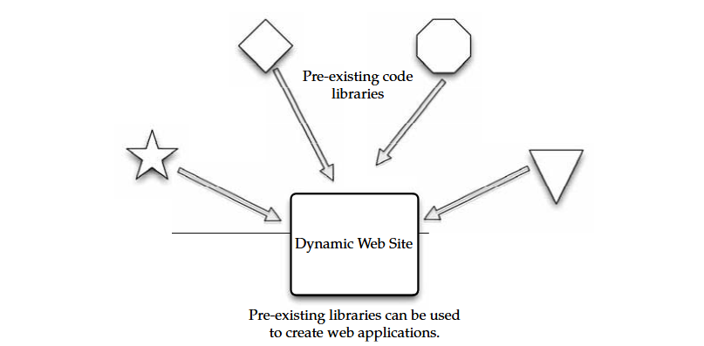
Accessing the Cloud
AJAX
Asynchronous JavaScript and XML (AJAX) is a group of web development techniques used for creating interactive web applications.
Using AJAX, web applications can retrieve data from the server asynchronously.
It is being done in the background, it won’t interfere with the display and behaviour of the current page.

Slide 3
Accessing the Cloud
Technologies :
AJAX is a term that represents a wide range of web technologies that can be used to help web applications communicate with a server, but without interfering with the current state of that page.
AJAX refers to these technologies: Extensible Hypertext Markup Language (XHTML) and Cascading Style Sheets (CSS) for presentation.
The Document Object Model for dynamic display of and interaction with data XML and Extensible Style Sheet Language Transformations (XSLT) for the interchange and manipulation of data, respectively.
The XML Http Request object for asynchronous communication JavaScript to bring these technologies together.
AJAX continues to evolve. For instance, while JavaScript claims a place in the acronym for AJAX, it is not the only client-side language that can be used for developing an AJAX application.
JavaScript Object Notation (JSON) is a widely used alternative. HTML and plain text can also be used.

Slide 4
Accessing the Cloud
Advantages of AJAX :
Multiple pages on a web site contain the same information. If those pages were coded by hand, the same content would have to be written into each and every page.
AJAX allows a web application to simply retrieve new information and adjust how the content is presented. This is very efficient and reduces the amount of bandwidth consumed and reduces load times.
Using asynchronous requests allows the client’s web browser to be more interactive and respond quickly to user inputs. The user may even perceive the application to be faster.
Connections to the server are reduced, because scripts and style sheets need only be downloaded once.
Disadvantages to AJAX :
Dynamically created web pages do not show up in the browser’s history engine, so clicking on the Back button would not re-create the last seen page.
It is difficult to bookmark a dynamically created web page.
If a browser does not support AJAX or if JavaScript is disabled, AJAX functionality cannot be used.
There is no standards body behind AJAX, so there is no widely adopted best practice to test AJAX applications.

Slide 5
Accessing the Cloud
Python Django :
Django is an open-source web application framework written in Python. Originally it was created to manage news sites for The World Company and released publicly under a BSD license in July 2005.
In June 2008 it was announced that the Django Software Foundation will be the authority for Django.
Django was developed to ease the creation of database-driven web sites and uses reusability of components. Django utilizes the principle of DRY (Don’t Repeat Yourself).
It also uses an administrative CRUD (create, read, update, and delete) interface that is dynamically generated.
Included in the core framework are :
A lightweight, stand-alone web server for development and testing.
A caching framework, which can use any of several cache methods.
An internal dispatcher system that allows an application’s components to communicate using predefined signals.
An internationalization system that translates Django’s components into multiple languages.
A scheme for extending the capabilities of the template engine.

Slide 6
Accessing the Cloud
Web Hosting Service :
A web hosting service that will allow you to store your data and applications.
Some web hosting services include Amazon Elastic Compute Cloud and Mosso.
Amazon Elastic Compute Cloud (EC2) :
Amazon Elastic Compute Cloud (http://aws.amazon.com/ec2) is a web service that provides resizable compute capacity in the cloud. Amazon EC2’s web service interface allows you to obtain and configure capacity with minimal friction.
It provides complete control of your computing resources and lets you run on Amazon’s computing environment. Amazon EC2 reduces the time required to obtain and boot new server instances to minutes, allowing you to quickly scale capacity, both up and down, as a client’s computing requirements change.
Amazon EC2 changes the economics of computing by allowing you to pay only for capacity that you actually use.

Slide 7
Accessing the Cloud
Amazon Elastic Compute Cloud (EC2) :
EC2 uses Xen virtualization. Each virtual machine, called an instance, is a virtual private server and can be one of three sizes: small, large, or extra large.
Instances are sized based on EC2 Compute Units, which is the equivalent CPU capacity of physical hardware.
One EC2 Compute Unit equals a 1.0–1.2GHz 2007 Opteron or 2007 Xeon processor.
The service initially offered Sun Microsystems OpenSolaris and Solaris Express Community Edition. In October 2008, EC2 added the Linux and Windows Server 2003 operating systems to its offerings.
Mosso :
Mosso is the home of The Hosting Cloud and CloudFS, providing enterprise-grade hosting and storage services.
Mosso provides an easily managed interface so that developers, designers, and IT managers can deploy reliable web applications quickly and easily as well as a high-performance cloud-based storage service.

Slide 8
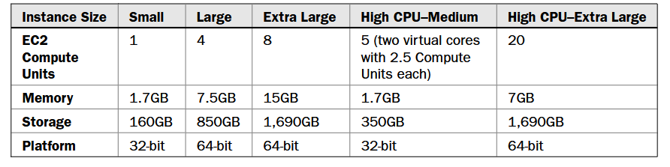
Accessing the Cloud
There are three components to Mosso’s offering:
• Cloud Sites Advertised as “the fastest way to put sites on the cloud”; runs Windows or Linux applications across hundreds of servers.
• Cloud Files Provides unlimited online storage for media (examples include backups, video files, user content), which is served out via Limelight Networks’ Content Delivery Network.
• Cloud Servers Able to deploy from one to hundreds of cloud servers instantly and creates advanced, high-availability architectures.

Slide 9
Accessing the Cloud
Proprietary Methods
Microsoft and Force.com are two examples of companies that have designed their own infrastructure for connecting to the cloud.
Azure
The Azure Services Platform is Microsoft’s cloud solution that spans from the cloud to the enterprise datacenter. Further, it delivers content across the PC, web, and phone.
The platform combines cloud-based developer capabilities with storage, computational, and networking infrastructure services, all hosted on servers operating within Microsoft’s global datacenter network.
This provides developers with the ability to deploy applications in the cloud or on-premises and enables experiences across a broad range of business and consumer scenarios.
The Azure Services Platform provides developers with the ability to create applications while taking advantage of their existing skills, tools, and technologies such as the Microsoft .NET Framework and Visual Studio.

Slide 10
Accessing the Cloud
Developers also can choose from a broad range of commercial or open-source development tools and technologies, and access the Azure Services Platform using a variety of common Internet standards including HTTP, representational state transfer (REST), and Atom Publishing Protocol (AtomPub).
Key components of the Azure Services Platform include the following:
Windows Azure for service hosting and management, low-level scalable storage, computation, and networking
Microsoft SQL Services for a wide range of database services and reporting
Microsoft .NET Services, which are service-based implementations of familiar .NET Framework concepts such as workflow and access control.
Live Services for a consistent way for users to store, share, and synchronize documents, photos, files, and information across their PCs, phones, PC applications, and web sites.
Microsoft SharePoint Services and Microsoft Dynamics CRM Services for business content, collaboration, and rapid solution development in the cloud As a key part of their cloud offering.
Microsoft has built datacenters to deliver online services. Microsoft has opened major datacenters in Quincy, Washington, and San Antonio, Texas, with additional centers scheduled to open in Chicago and in Dublin, Ireland.

Slide 11
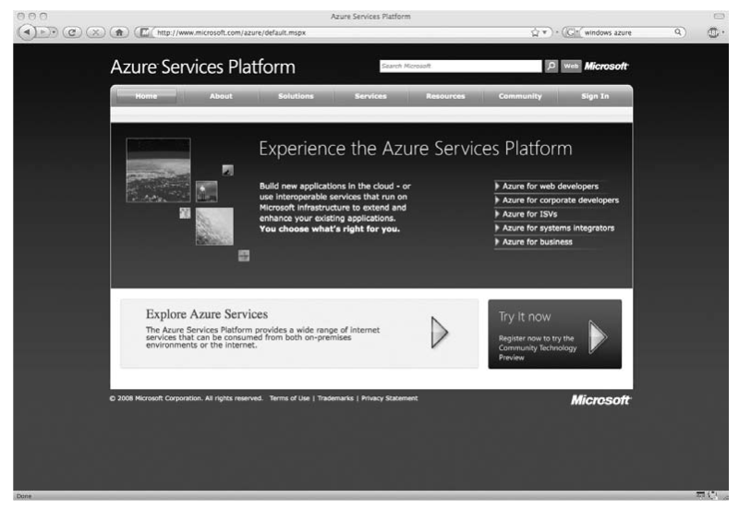
Accessing the Cloud

Slide 12
Accessing the Cloud
Force.com
Force.com, a PaaS from Salesforce.com, is another way to create and deploy business applications. By replacing the complexity of software platforms with a complete, scalable service, Force.com provides developers a fast path to turn ideas into business impact.
Force.com Features Force.com PaaS provides the building blocks necessary to build any kind of business application, and automatically deploy them as a service to small teams or entire enterprises.
The Force.com platform gives customers the ability to run multiple applications within the same Salesforce.com instance, allowing all of a company’s Salesforce.com applications to share a common security model, data model, and user interface.
The multitenant Force.com platform encompasses a complete feature set for the creation of business applications such as an on-demand operating system.
The ability to create any database on demand, a workflow engine for managing collaboration between users, the Apex Code programming language for building complex logic, the Force.com Web Services API for programmatic access, mashups, and integration with other applications and data, and now Visualforce for a framework to build any user interface.

Slide 13
Accessing the Cloud
Visualforce As part of the Force.com platform, Visualforce gives customers the ability to design application user interfaces for any experience on any screen.
Using the logic and workflow intelligence provided by Apex Code, Visualforce offers the flexibility to meet the
requirements of applications that feature many different types of users on a variety of devices.
Visualforce uses HTML, AJAX, and Flex for business applications. Visualforce enables the creation and delivery of any user experience, offering control over an application’s design and behavior.
Visualforce provides a page-based model, built on standard HTML and web presentation technologies, and is complemented with both a component library for implementing common user interface elements and a controller model for creating new interactions between those elements.
Visualforce features and capabilities include :
Pages Enables the design definition of an application’s user interface. This enables developers to create new pages using standard web technologies including HTML, AJAX, and Flex. Pages allows developers to create any user experience with standard web technologies.

Slide 14
Accessing the Cloud
Components Provides the ability to create new applications that automatically match the look and feel of Salesforce applications or easily customize and extend the Salesforce user interface to specific customer and user requirements
Customers can create a user experience by assembling existing user interface elements.
Logic Controllers Enables customers to build any user interface behavior.
Customers can use Visualforce to quickly create a new look and feel that leverages existing application functionality. The standard controller gives customers the ability to inherit and reuse any standard Salesforce UI behavior like new, edit, and save.

Slide 15
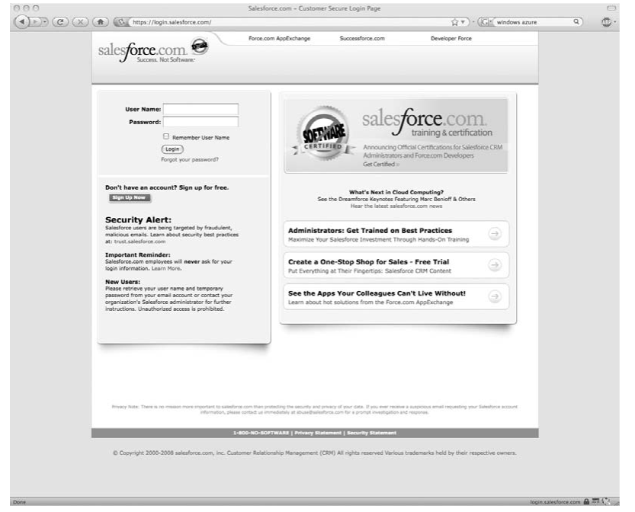
Accessing the Cloud

Slide 16
Accessing the Cloud
Web sample Applications :
Different companies offer different things, but for the sake of understanding the market, let’s take a closer look at cloud giant Google and their offerings.
They have a slate of apps that are targeted right toward your enterprise. Following this link (http://www.google .com/apps/intl/en/business/index.html) will take you to their apps.
Google Apps, launched as a free service in August 2006, is a suite of applications that includes :
• Gmail webmail services
• Google Calendar shared calendaring
• Google Talk instant messaging and Voice Over IP
• Start Page for creating a customizable home page on a specific domain

Slide 17
Accessing the Cloud
More than 100,000 small businesses and hundreds of universities now use the service.
“So much of business now relies on people being able to communicate and collaborate effectively,” said Gregory Simpson, CTO for General Electric Company.
“GE is interested in evaluating Google Apps for the easy access it provides to a suite of web applications, and the way these applications can help people work together.
Given its consumer experience, Google has a natural advantage in understanding how people interact together over the web.” Google also offers a premium service called Google Apps Premier Edition.
Google Apps Premier Edition has the following unique features:
Per-user storage of 10GBs Offers about 100 times the storage of the average corporate mailbox, eliminating the need to frequently delete email.
APIs for business integration APIs for data migration, user provisioning, single sign-on, and mail gateways enable businesses to further customize the service for unique environments.

Slide 18
Accessing the Cloud
• Uptime of 99.9 percent Service Level Agreements for high availability of Gmail, with Google monitoring and crediting customers if service levels are not met.
• Support for critical issues 24/7 Includes extended business hours telephone support for administrators.
• Advertising optional Advertising is turned off by default, but businesses can choose to include Google’s relevant target-based ads if desired.
• Low fee Simple and affordable annual fee (US$50 per user account per year) makes it practical to offer these applications to everyone in the organization.
In addition to Gmail, Google Calendar, Google Talk and Start Page, all editions of Google Apps also include :
• Google Docs and Spreadsheets With this addition, teams can collaborate on documents and spreadsheets without the need to email documents back and forth.
Multiple employees can securely work on a document at the same time. All revisions are recorded for editing, and administrative controls allow organizations to define limits on document sharing.

Slide 19
Accessing the Cloud
• Gmail for mobile devices on BlackBerry Gmail for mobile devices provides the same Gmail experience—such as search, conversation view, and synchronization with desktop version—on BlackBerry handheld devices for users of
Google Apps.
Gmail for mobile devices joins a list of other mobile options for Google Apps and BlackBerry users that already includes a Google Talk client and a variety of calendar sync tools.
Application-level control Allows administrators to adapt services to business policies, such as sharing of calendars or documents outside of the company.
To provide more options and value to customers of Google Apps Premier Edition, Google Enterprise Professional partners like Avaya and Postini are developing a variety of solutions based on Google’s APIs.
Including email gateways, enhanced security, Google Calendar synchronization, and third-party integration with Google Talk, as well as offering deployment, migration, and additional support services.
Google-hosted applications are available in many languages, such as French, Italian, German, Spanish, Chinese, Japanese, and Korean. You can find more information at http://www.google.com/ .

Slide 20
Accessing the Cloud
Different cloud providers use different APIs.
What Are APIs?
An application programming interface (API) is a set of programming instructions and standards for accessing a web-based program. Software companies release their APIs to the public so that other software developers can design products that are powered by its service.
For example, Amazon released its own API so that web site developers could more easily access information maintained at the Amazon web site.
By using Amazon’s API, a third-party web site can directly link to products on the Amazon site.
APIs allow one program to speak with another. They are not user interfaces. Using APIs, programs can speak to each other without the user having to be involved.

Slide 21
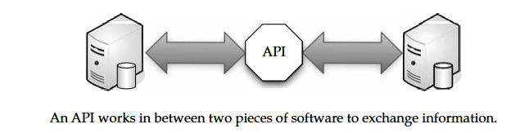
Accessing the Cloud
For instance, when you buy something at Amazon and enter your credit card information, Amazon uses an API to send your credit card information to a remote application that verifies whether your information is correct. As a user, all you saw was the place to enter your credit card information, but behind the scenes, APIs were getting the job done.
An API is similar to Software as a Service (SaaS), because software developers don’t have to start from scratch every time they write a program. Rather than build one program that does everything (email, billing tracking, and so forth), the application can farm out those duties to other applications that do it better.

Slide 22
Accessing the Cloud
How APIs Work :
An API is (as the acronym says) an interface that defines the way in which two things will communicate. With APIs, the calls back and forth are managed by web services.
Web services are a collection of standards including XML, the programming language that allows applications to communicate over the Internet. XML is a general-purpose markup language.
The structured data in a way that both humans and computers can read and write.
The API is a piece of software code written as a series of XML messages, like the one for the Google Maps API shown here:
<script type="text/javascript“ , src="http://www.google.com/jsapi?key=ABCDEFG"></script>
<script type="text/javascript"> , google.load("maps", "2.x"); // Call this function when the page has been loaded
function initialize() {
var map = new google.maps.Map2(document.getElementById("map"));
map.setCenter(new google.maps.LatLng(37.4419, -122.1419), 13); }
google.setOnLoadCallback(initialize); </script>

Slide 23
Accessing the Cloud
Programmers can use APIs by programming new or existing applications to generate the right XML messages to utilize remote applications.
For instance, if you wanted to archive emails on the cloud, you could use an API to automatically send emails from your inboxes to the cloud archive.
Companies that release their API usually do so as part of a larger software development kit (SDK) that includes the API, programming tools, and documentation.
APIs and web services are invisible to your users as they access the cloud. Their whole purpose is to run silently in the background, doing the job for which they were created.
XML isn’t the only standard that makes APIs work. Other standards include; SOAP (Simple Object Access Protocol) SOAP encodes XML messages so that they can be received and understood by any operating system over any type of network protocol.
UDDI (Universal Description, Discovery, and Integration) UDDI is an XML based directory that allows businesses to list themselves, find each other, and collaborate using web services.
WSDL (Web Services Description Language) WSDL is the SOAP of UDDI. WSDL is the XML-based language that businesses use to describe their services in the UDDI.

Slide 24
Accessing the Cloud
API Creators
There are many different APIs you can use to link your organization with your cloud applications
You might have to create your own APIs.
Google Gadgets
Google Gadgets are a desktop search application that enables users to search their email, files, web history, and chats. Called Google Desktop Search, this new application makes it possible for users to find information on their computers as fast and easily as they can search the Web with Google.
The Google Gadgets API is composed of three languages:
XML This is the language you use to write gadget specifications. A gadget is just an XML file, placed on the Web somewhere where Google can find it.

Slide 25
Accessing the Cloud
The XML file contains the instructions on how to process and render the gadget. The XML file can contain all the data, or it can have reference URLs where the data can be found.
HTML HTML is the markup language used to format the pages on the web. It is generally responsible for the static portions of your web pages.
HTML and XML look similar, but HTML is used to format web documents, whereas XML is used to describe structured data.
JavaScript JavaScript is the scripting language you can use to add dynamic behavior to your gadgets.
Google Desktop Search is a lightweight, free, downloadable application that brings
Google search to information on your computer. The application operates locally on the user’s computer, where it provides the following capabilities:

Slide 26
Accessing the Cloud
System-wide search Users can search across their email and a wide range of files and information such as email in Microsoft Outlook and Outlook Express; files in Microsoft Word, Microsoft Excel,
Microsoft PowerPoint, and text; web site history in Internet Explorer; and instant message chats in AOL Instant Messenger.
High search speed Google.com can search billions of web pages in a fraction of a second. Google Desktop Search is built with the same technology, and it can search a single hard drive in even less time.
Easy access to desktop results via Google.com Google Desktop Search enables users to search both their computer and the Web simultaneously.
When users search through Google.com (either from the home page or the Google Toolbar), Google Desktop Search runs the same search in parallel on the user’s computer.

Slide 27
Accessing the Cloud
If Google Desktop Search finds relevant results, those results are added to the Google.com search results page. This means that users don’t need to decide before they search whether to search the Web or their computer.
Dynamic results Unlike traditional computer search software that updates once a day, Google Desktop Search updates continuously for most file types.
When a user downloads a new email in Outlook, for example, it can be found within seconds using Google Desktop Search. Google Desktop Search is available at http://desktop.google.com.
Google Data APIs
The Google Data APIs provide a simple standard protocol for reading and writing data on the Web. They encompass a broad range of business functions that can be used to link your applications within and outside of the cloud.
Description These REST-style APIs are based on the Atom Publishing Protocol (AtomPub), and use the Atom syndication format to represent data and HTTP to handle communication.

Slide 28
Accessing the Cloud
The Google Data APIs include
Google Apps APIs
Google Base Data API
Blogger Data API
Google Book Search Data API
Google Calendar Data API
Google Code Search Data API
Google Contacts Data API
Google Documents List Data API
Google Finance Portfolio Data API
Google Health Data API
Google Notebook Data API
Picasa Web Albums Data API
Google Spreadsheets Data API
Webmaster Tools Data API
YouTube Data API

Slide 29
Accessing the Cloud
Partnership Salesforce.com partnered with Google, making it easier for developers to create applications for cloud computing.
The Force.com Toolkit for Google Data APIs provides a set of tools and services to allow developers to take advantage of Google Data APIs, a common set of standard APIs for interacting with data in Google services, within their applications and projects on Force.com.
The APIs are freely available at http://developer.force.com/ and http://code.google.com/ p/apex-google-data/.
The alliance between Salesforce.com and Google gives developers a multicloud computing platform for building and running applications.
The Force.com PaaS and Google’s open APIs and technologies enable the creation of powerful applications delivered on the Web.
Additionally, the Force.com Toolkit for Google Data APIs creates new opportunities for developers and ISVs to extend the widely adopted Salesforce for Google Apps.
The toolkit gives developers and partners the ability to create business applications that extend salesforce for Google Apps as well as build entirely new applications to help customers run their business in the cloud.

Slide 30
Accessing the Cloud
GoGrid
GoGrid’s API is a web service that allows developers to control their interaction with GoGrid’s cloud hosting infrastructure.
The GoGrid API provides two-way communication for controlling GoGrid’s control panel functionality. Typical uses for the API include
Auto-scaling network servers
Listing assigned public and private IP addresses
Deleting servers
Listing billing details
GoGrid’s REST-like API Query interface is designed for individuals who want to programmatically control their cloud hosting infrastructure over the Internet.
The GoGrid API requires you to be a GoGrid customer and to have technical knowledge and programming skills.
The GoGrid API supports these languages:
Java
PHP
Python
Ruby

Slide 31
Accessing the Cloud
Apex
The Apex Web Services API is one of the world’s most widely used enterprise web services, handling more than 50 percent of Salesforce.com’s 3.7 billion service transactions.
The Apex Web Services API makes it possible to access and manage complex data relationships—such as a set of information about an account, all the products they have bought, and all of their contacts—in a single request.
This capability, analogous to database JOIN functionality, enhances both the speed and simplicity of integrations, and will be unique to the Apex API.
Development Platform Apex is a development platform for building Software as a Service (SaaS) applications on top of Salesforce.com’s customer relationship management (CRM) functionality.
By using Apex, developers can access Salesforce.com’s back-end database and client-server interfaces to create SaaS applications.
This API allows developers to use common SaaS components, like web widgets or a multitenant database, without the need to develop much of the infrastructure traditionally associated behind SaaS programs.

Slide 32
Accessing the Cloud
The Apex platforms consist of three tools:
• Apex Builder An on-demand component allowing easy drag-and-drop customization with a limited set of features.
• Apex API A method of retrieving raw data from Salesforce.com’s servers. The API is used by programs that are external to Salesforce.com, like Java applications that need access to information on a client’s Salesforce.com account.
• Apex Code A programming language that is executed on Salesforce.com’s servers. The Apex Code offers flexibility in developing by using the Apex API while reducing the number of calls between the client and server.
Sample Code The following is an example of an Apex API. The code defines a system that
prevents duplicate records, based on email address, from being entered into the system.
trigger blockDuplicates_tgr on Lead bulk(before insert, before update) {
/** begin by building a map which stores the (unique) list of leads * being inserted/updated, using email address as the key. */
Map<String, Lead> leadMap = new Map<String, Lead>();
for (Lead lead : System.Trigger.new) {
if (lead.Email != null) { // skip null emails /* for inserts OR * updates where the email address is changing
* check to see if the email is a duplicate of another in this batch, if unique, add this lead to the leadMap*/

Slide 33
Accessing the Cloud
if ( System.Trigger.isInsert ||
(System.Trigger.isUpdate &&
lead.Email !=
System.Trigger.oldMap.get(lead.Id).Email)) {
if (leadMap.containsKey(lead.Email)) {
lead.Email.addError('Another new lead has the
same email address.');
} else {
leadMap.put(lead.Email, lead);
}}}}
/* Using the lead map, make a single database query,
* find all the leads in the database that have the same email address.
* as any of the leads being inserted/updated.
*/ for (Lead lead : [select Email from Lead where Email IN
:leadMap.KeySet()]) {
Lead newLead = leadMap.get(lead.Email);
newLead.Email.addError('A lead with this email address already
exists.');}}

